Slide 1
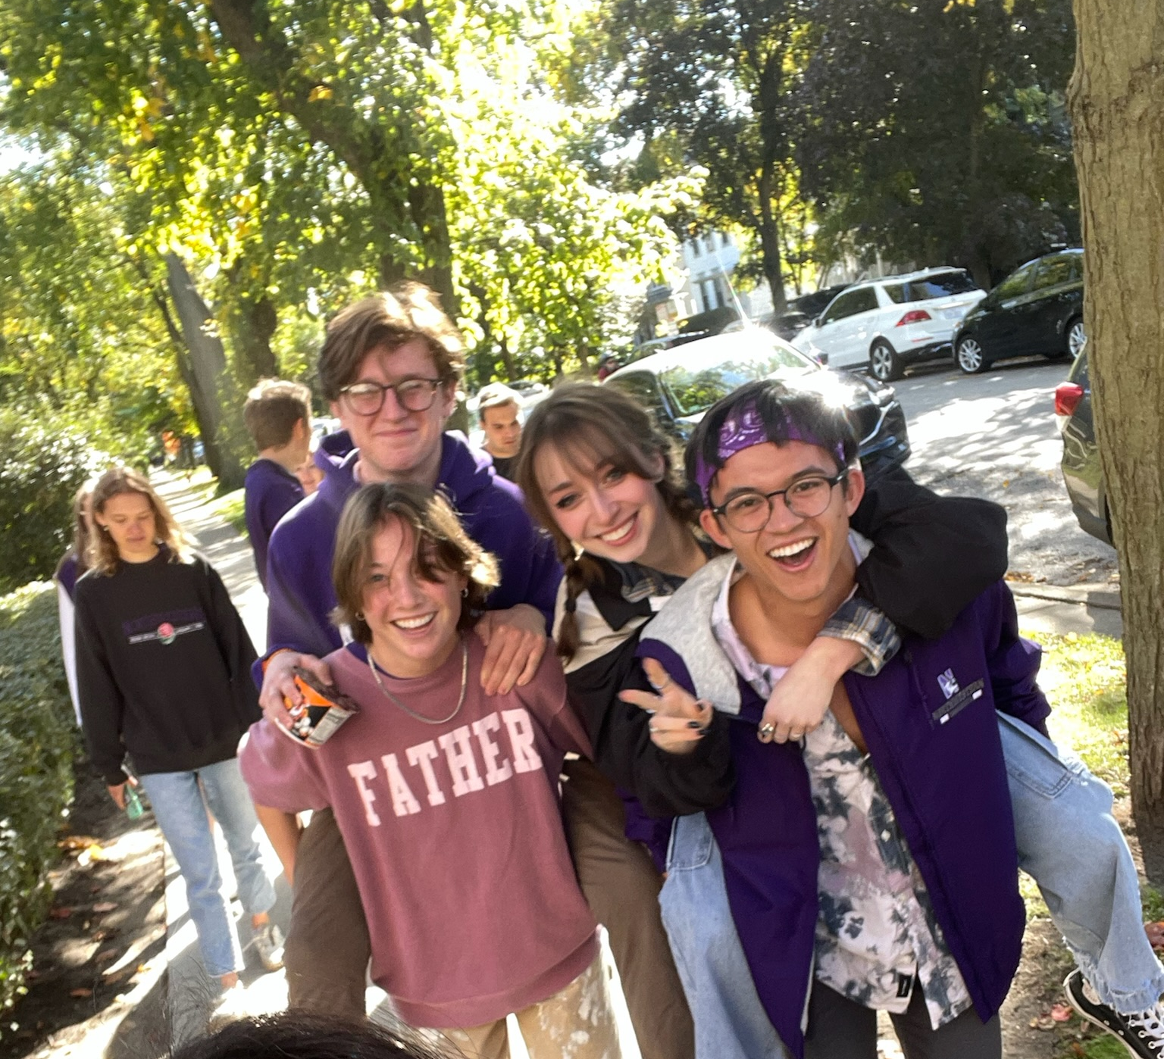
Aileen Cleary
I’m from Winnetka, IL, in the Chicago area.
I study Mechanical Engineering at Northwestern University.
I’m looking forwards to getting my first real research experience and working on some really cool robotics with everyone.
That’s me!

